Slide 1
Complexity Analysis
Notes:
CSC2105
Sajib Hasan

Slide 2
Analysis of Algorithms
Efficiency:
  Running time
  Space used
Efficiency as a function of the input size:
  Number of data elements (numbers, points).
  The number of bits of an input number .
Introduction→<number>

Slide 3
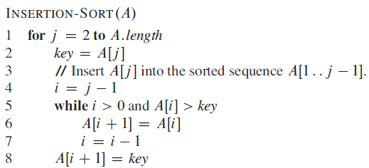
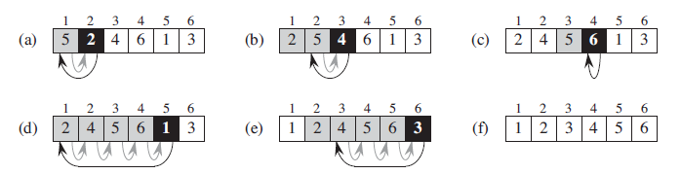
Insertion Sort
Introduction→<number>

Slide 4
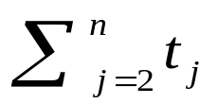
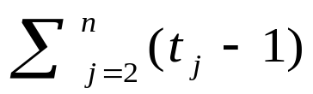
Analysis of Insertion Sort
Time to compute the running time as a function of the input size (exact analysis).
for j := 2 to n do
key := A[j]
// Insert A[j] into A[1..j-1]
i := j-1
while i>0 and A[i]>key do
A[i+1]:=A[i]
i--
A[i+1]:=key
cost
c₁
c₂
0
c₃
c₄
c₅
c₆
c₇
times
n
n-1
n-1
n-1
n-1
Introduction→<number>

Slide 5
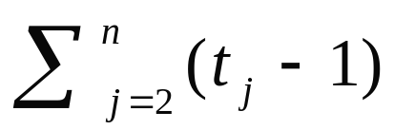
…Analysis of Insertion Sort
The running time of an algorithm is the sum of the running times of each statement.
A statement with cost c that is executed n times contributes c*n to the running time.
The total running time T(n) of insertion sort is
  T(n)= c₁*n + c₂(n-1) + c₃(n-1) + c₄ + c₅ + c₆
  + c₇ (n-1)
Introduction→<number>

Slide 6
…Analysis of Insertion Sort
Often the performance depends on the details of the input (not only the length n).
This is modeled by t_{j.}
In the case of insertion sort the time t_{j} depends on the original sorting of the input array.
Introduction→<number>

Slide 7
Performance Analysis
Performance often draws the line between what is feasible and what is impossible.
Often it is sufficient to count the number of iterations of the core (innermost) part.
  No distinction between comparisons, assignments, etc (that means roughly the same cost for all of them).
  Gives precise enough results.
In some cases the cost of selected operations dominates all other costs.
  Disk I/O versus RAM operations.
  Database systems.
Introduction→<number>

Slide 8
Best/ Worst/ Average Case
Best case: works fast on some input.
Worst case: (usually) maximum time of algorithm on any input of size.
Average case: (sometimes) expected time of algorithm over all inputs of size. Need assumption of statistical distribution of inputs.
Analyzing insertion sort’s
  Best case: elements already sorted, t_{j}=1, running time ≈ (n-1), i.e., linear time.
  Worst case: elements are sorted in inverse order, t_{j} = j-1, running time ≈ (n²-n)/2 , i.e., quadratic time.
  Average case: t_{j} = j / 2, running time ≈ (n²+n-2)/4 , i.e., quadratic time.
Introduction→<number>

Slide 9
…Best/ Worst/ Average Case
  For inputs of all sizes:
worst-case
6n
average-case
5n
best-case
Running time
4n
3n
2n
1n
1 2 3 4 5 6 7 8 9 10 11 12 …..
Input instance size
Introduction→<number>

Slide 10
…Best/ Worst/ Average Case
Worst case is usually used:
  It is an upper-bound.
  In certain application domains (e.g., air traffic control, surgery) knowing the worst-case time complexity is of crucial importance.
  For some algorithms worst case occurs fairly often
  The average case is often as bad as the worst case.
  Finding the average case can be very difficult.
Introduction→<number>

Slide 11



Asymptotic Notation
The “big-Oh” O-Notation
  asymptotic upper bound
  f(n) = O(g(n)), if there exists constants c>0 and n₀>0, s.t. f(n) ≤ c g(n) for n ≥ n₀
  f(n) and g(n) are functions
  over non- negative integers
Used for worst-case analysis
Running Time
Input Size
Introduction→<number>

Slide 12


...Asymptotic Notation
The “big-Omega” Ω−Notation
  asymptotic lower bound
  f(n) = Ω(g(n)) if there exists constants c>0 and n₀>0, s.t. f(n)>=c g(n) for n ≥ n₀
Used to describe best-case running times or lower bounds of algorithmic problems.
E.g., lower-bound of searching in an unsorted array is Ω(n).
Running Time
Input Size
Introduction→<number>

Slide 13


...Asymptotic Notation
The “big-Theta” Θ−Notation
  asymptoticly tight bound
  f(n) = Θ(g(n)) if there exists constants c₁>0, c₂>0, and n₀>0, s.t. for n ≥ n₀ c₁ g(n) ≤ f(n) ≤ c₂ g(n)
f(n) = Θ(g(n)) if and only if f(n) = Ο(g(n)), f(n) = Ω(g(n))
O(f(n)) is often abused instead of Θ(f(n))
Running Time
Input Size
Introduction→<number>

Slide 14
Asymptotic Analysis
Goal: to simplify the analysis of the running time by getting rid of details, which are affected by specific implementation and hardware
  rounding of numbers: 1,000,001 ≈ 1,000,000
  rounding of functions: 3n² ≈ n²
Capturing the essence: how the running time of an algorithm increases with the size of the input in the limit.
  Asymptotically more efficient algorithms are best for all but small inputs
Introduction→<number>

Slide 15
...Asymptotic Analysis
Simple Rule: Drop lower order terms and constant factors.
  50 n log n is O(n log n)
  7n - 3 is O(n)
  8n² log n + 5n² + n is O(n² log n)
Introduction→<number>

